Slide 1
p53 is Positively Regulated by miR-542-3p
Applied genomics project

Slide 2
Results
Identification of miR-542 as a positive regulator of p53 expression
A high throughput fluorescence microscopy cell-based assay was used by taking the average immuno-fluorescent
staining intensity of p53 in the nucleus after transfection of miRNA mimics.
The screening was performed using U20S cells where 15 negative and 13 positive potential regulators were applied.
p53 expression was significantly enhanced by the positive regulators the highest being caused by
miR-542-3p.

Slide 3
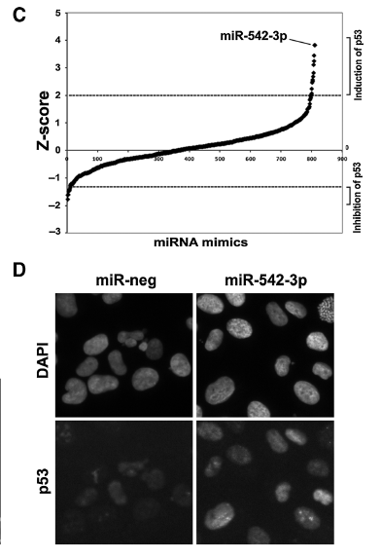
Z-score & immunofluorescence staining by miR-542-3P
C) Z-score plot of miRNA mimics in the regulation of nuclear p53 immunofluorescent intensity.
D) Representative images of p53 immunofluorescence staining in miR-neg or miR-542-3p–transfected cells

Slide 4
miR-542-3p disrupts p53-MDM2 interaction and increases the stability of p53 protein
miR-542-3p increases stability of p53 protein. This was illustrated by treating U20 cells with protein synthesis inhibitor cycloheximide where it was noted that overexpression of miR-542-3p increased the half life of p53 from approximately 50 to 130 minutes.
It disrupts the interaction between p53 and MDM2 by inhibition of proteasome-mediated degradation of wild-type p53 protein .
MiR-542-3p does not affect the expression of MDM2, PIRH2, MDM4, and PA28g. However, it affects other regulators of p53–MDM2 leading to attenuation(reduction) of the interaction between p53 and MDM2 as well as the polyubiquitination of p53 for example in HCT116 cells(wild type p53 ,colon cancer)

Slide 5
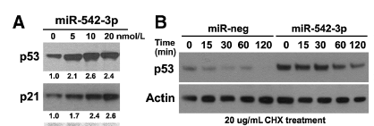
miR-542-3p increases the stability of p53 protein
miR-542-3p induces p53 expression at indicated concentration (nmol/L)
miR-542-3p increases the stability of p53 protein when treated with protein synthesis cycloheximide.
The half life increased from approximately 50 to 130 minutes.

Slide 6
miR-542-3p induces ribosomal p53 response
miR-542-3p suppresses the maturation of 18S rRNA , the core of ribosome 40S rRNA subunit to induce the ribosomal p53 response.
Downregulation of ribosomal subunits RPS23 and RPS28 can cause ribosome biogenesis defects and reduce 18S rRNA levels, while knockdown of RPL22 has no effect on production of both 28S and 18S rRNA.
RPS23 depletion induced p53 by two-fold, whereas depletion of RPS28 or RPL22 had very mild effect on p53 level.
miR-542-3p induces p53 mainly through suppression of RPS23, which leads to upregulation of RPL11 and isolation of MDM2 by RPL11.

Slide 7
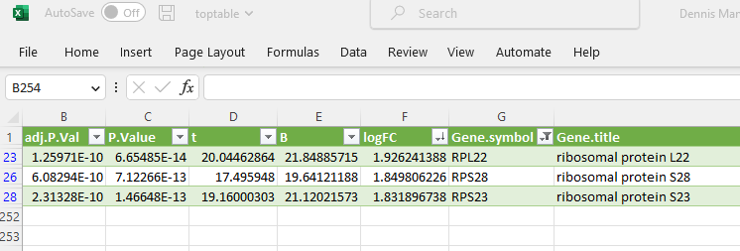
Components of Ribosomes that were modulated by miR-542-3p

Slide 8
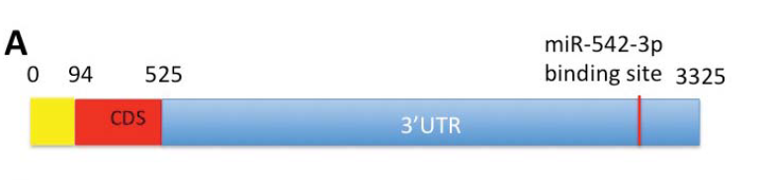
RPS23 is a direct target of miR-542-3p
RPS23 mRNA contains a predicted binding site of miR-542-3p in its 3’UTR.
miR-542-3p downregulates luciferase activity of a construct fused with RPS23 3’UTR and this effect is abolished
when the potential miR-542-3p-binding site in RPS23 3’UTR is mutated.
Direct targeting of the 3’UTR of RPS23 by miR-542-3p is partially responsible for miR-542-3p-mediated RPL11 and p53 induction.

Slide 9
miR-542-3p activates p53 pathway in MDM2-over expressing or ARF-deficient cells
MDM2 amplification and ARF(Alternative reading frame) gene deficiency are responsible for suppression of p53 function in tumors with wild-type TP53.
miR-542-3p can rescue p53 protein expression in MDM2-overexpressing or ARF-deficient cells as shown in JHOC7, OVISE, and LN229 cancer cell lines where p53 expression significantly increased and RPS23 levels reduced.
Overexpression of miR-542-3p suppresses cell growth of different types of cancer cells;U20S,LN229,OVISE & JHOC7 significantly, mainly due to cell cycle arrest at G1.

Slide 10
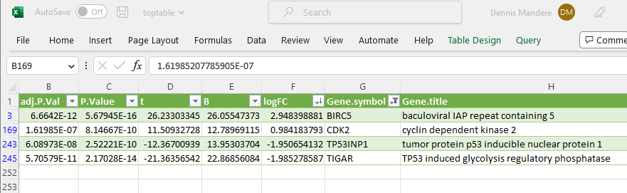
Components of p53 signaling pathway that were significantly affected by miR-542-3p in U2OS cells

Slide 11
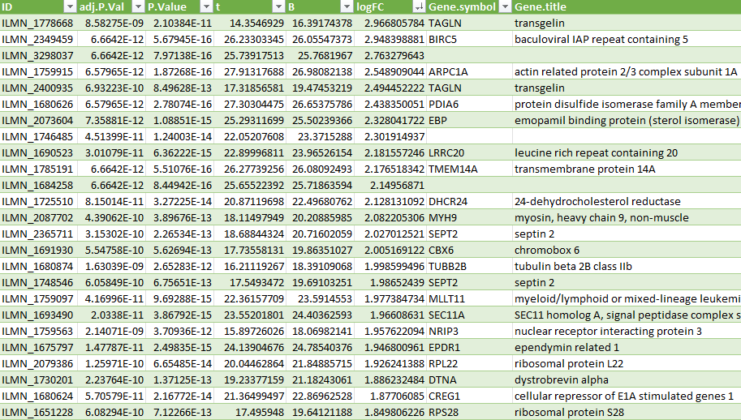
Snapshot of top differentially expressed genes

Slide 12
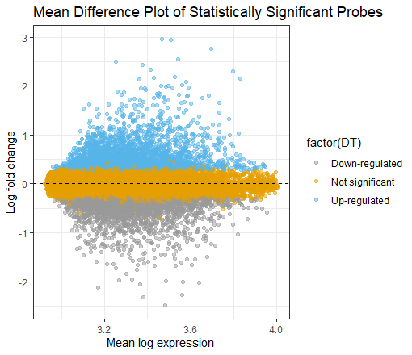
Mean difference plot
Comparison of the mean expression levels of genes between control and treatment groups.
The Y axis represents the difference in mean expression levels between the two groups while the X axis shows the mean expression levels across all samples.
Each point on the plot represents a gene and they are colored to indicate their statistical significance.

Slide 13
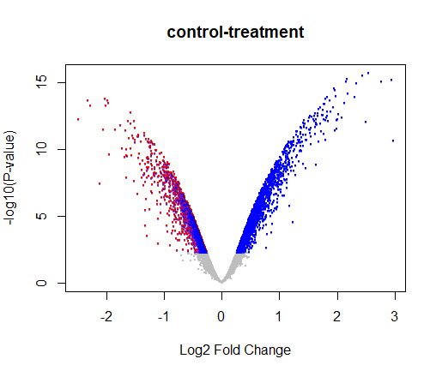
Volcano plot of Control vs treatment
Y axis indicates statistical significance of the difference in expression between the two groups(P-value) while the X axis shows the LogFC values,
A positive Log2 Fold change indicates upregulation of genes while a negative Log2 Fold change indicates a downregulation of genes

Slide 14
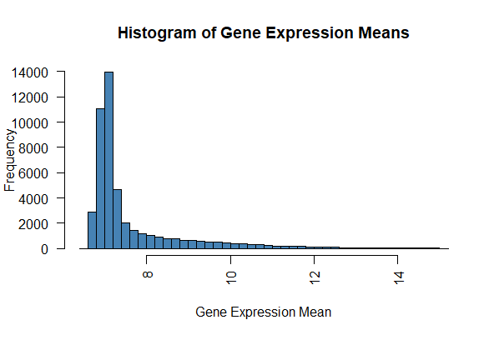
Histogram of gene expression means
Distribution of the average gene expression indicating that the highest frequency is below an expression mean of 8

